Slide 1
Chapter 6
Relational Algebra

Slide 2
Relational Algebra
RA is a procedural query language, which takes instances of relations as input and yields instances of relations as output.
It uses operators to perform queries.
An operator can be either unary or binary.
They accept relations as their input and yields relations as their output.
Relational algebra is performed recursively on a relation and intermediate results are also considered relations.

Slide 3
Relational Algebra
Unary operations of Relational algebra
Select
Projection
Binary operations of Relational algebra
Union
Set different
Cartesian product

Slide 4
Select Operation (σ)
Selects tuples that satisfy the given predicate/condition from a relation.
In general, the select operation is denoted by
σ _{<selection condition>}(R)
where
the symbol σ (sigma) is used to denote the select operator
the selection condition is a Boolean (conditional) expression specified on the attributes of relation R
tuples that make the condition true are selected
appear in the result of the operation
tuples that make the condition false are filtered out
discarded from the result of the operation

Slide 5
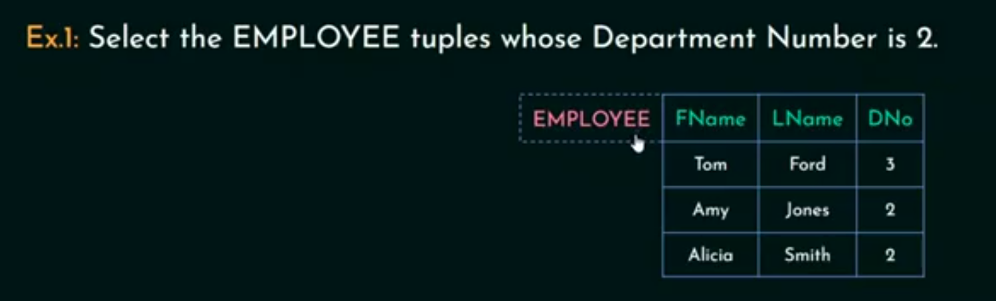
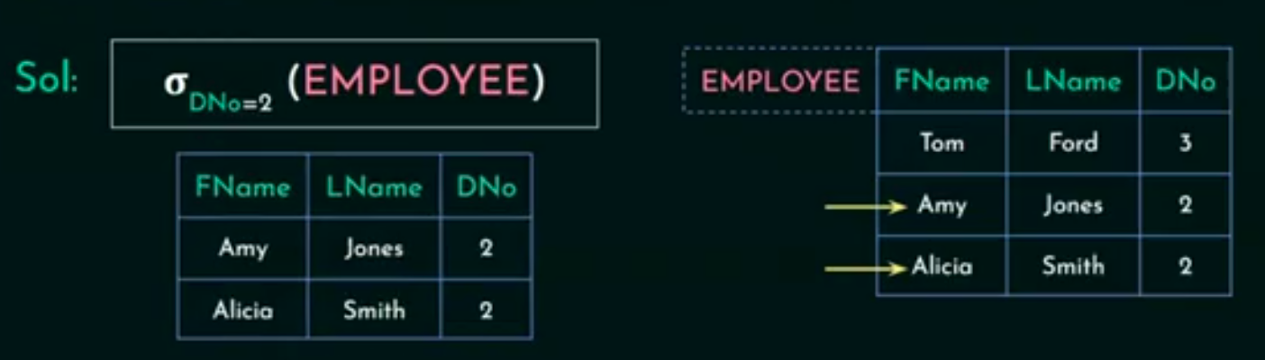
Select Operation Example

Slide 6
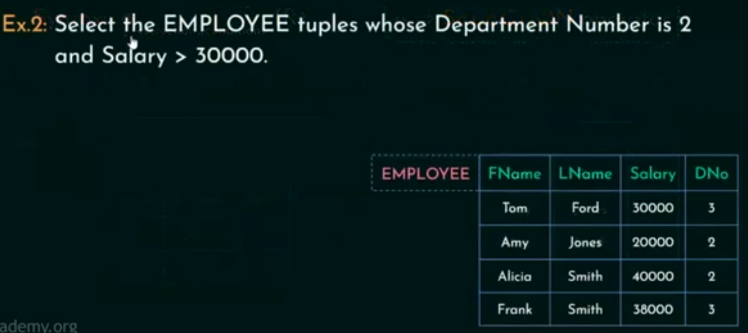
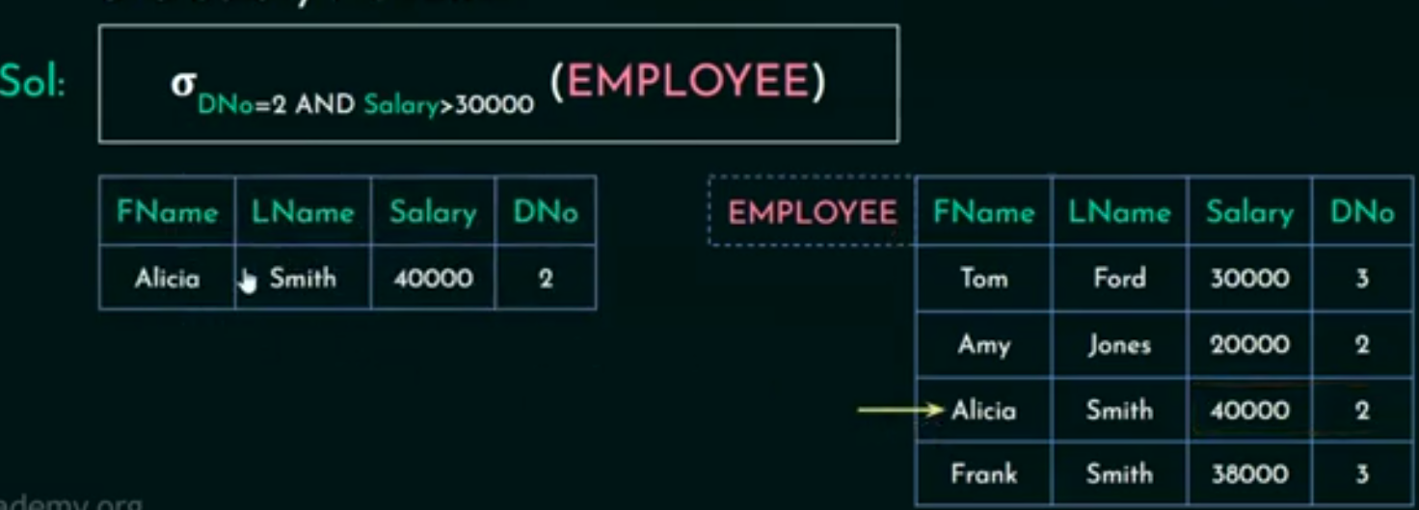
Cont’d

Slide 7
Projection Operation (∏)
Projects column(s) that satisfy given predicate.
This operation keeps certain columns (attributes) from a relation and discards the other columns.
PROJECT creates a vertical partitioning
The list of specified columns (attributes) is kept in each tuple
The other attributes in each tuple are discarded
Notation: ∏_{A1, A2, An} (r)
A₁, A₂ , A_{n} are attribute names of relation r
∏: Projection operator

Slide 8
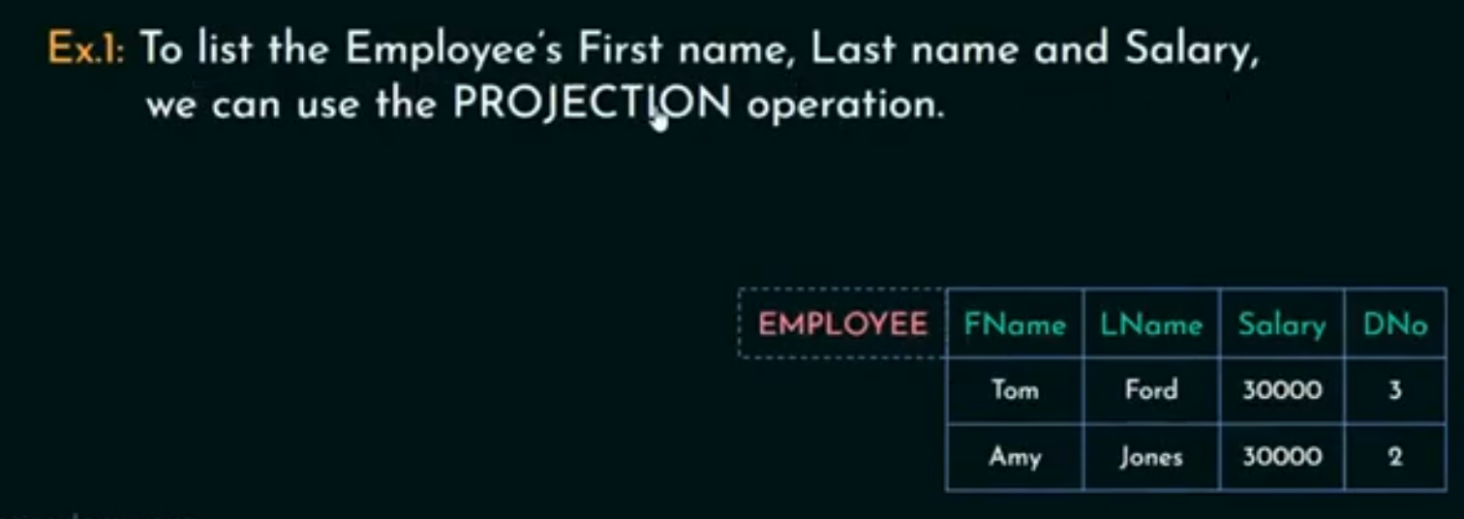
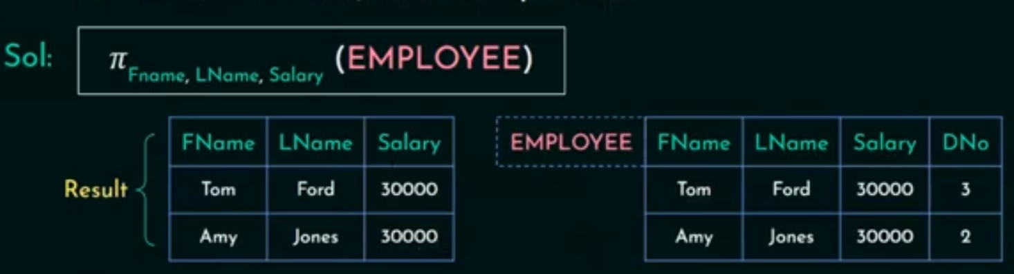
Projection Operation example

Slide 9

Union Operation (∪)
Union operation performs between two given relations
The result of R ∪ S, is a relation that includes all tuples that are either in R or in S or in both R and S.
Duplicate tuples are eliminated
For a union operation to be valid, the following conditions must hold:
r, s must have same number of attributes.
Attribute domains must be compatible.

Slide 10
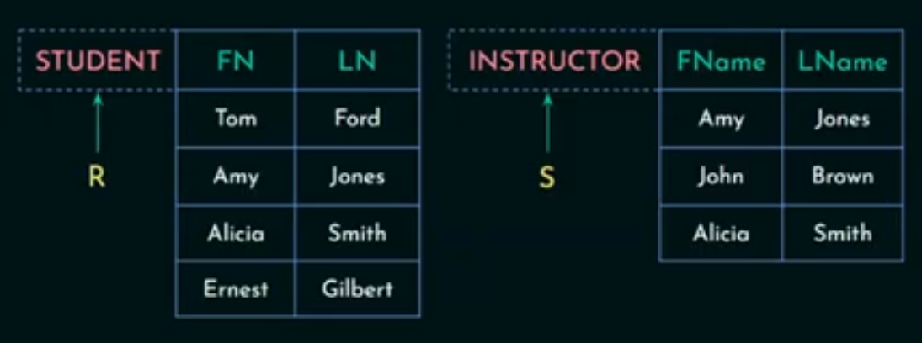
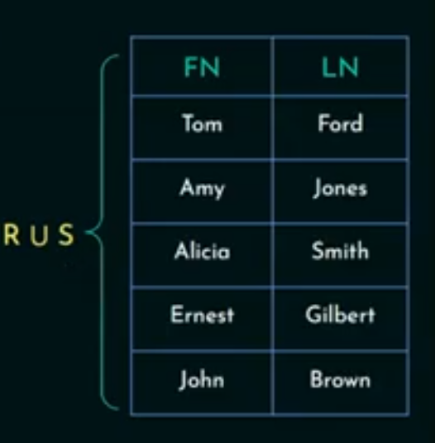
Union Operation (∪)

Slide 11
Intersection Operation (∩)
Intersection operation performs between two given relations
The result of R ∩ S, is a relation that includes all tuples that are in both R and S.
For a Intersection operation to be valid, the following conditions must hold:
r, s must have same number of attributes.
Attribute domains must be compatible.

Slide 12
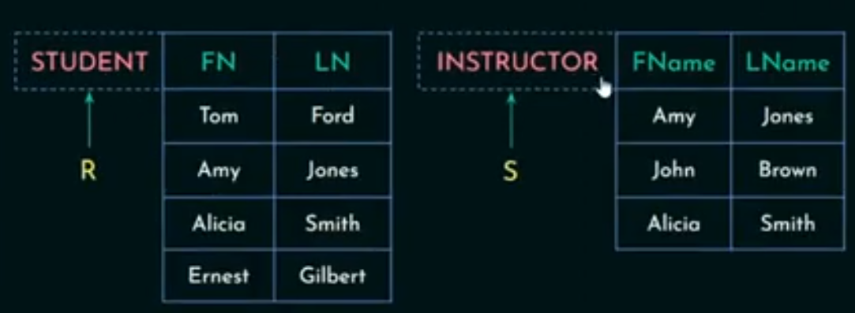
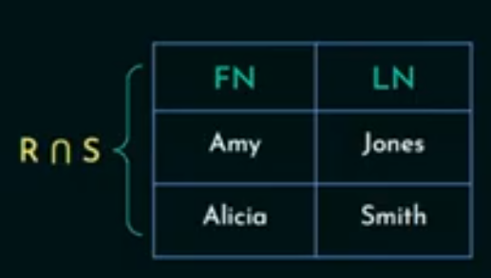
Intersection Operation (∩)

Slide 13
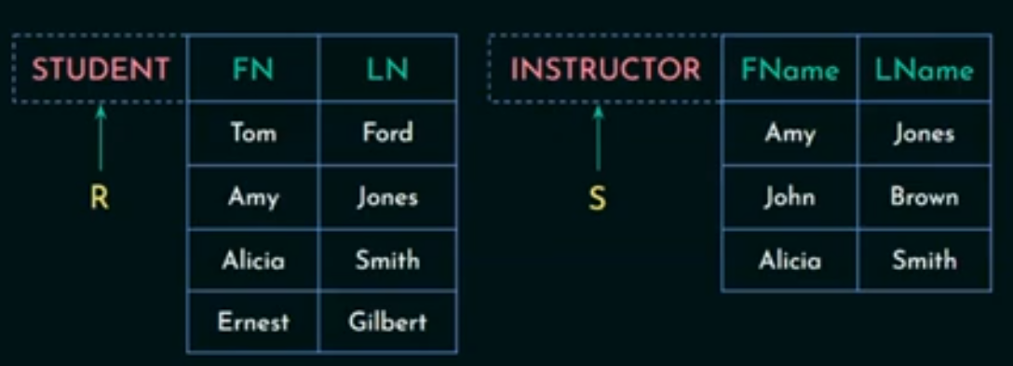
Set Difference ( − )
The result of R − S, is a relation that include all tuples that are present in r but not s.

Slide 14
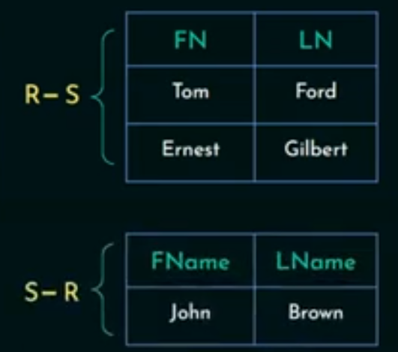
Set Difference result

Slide 15
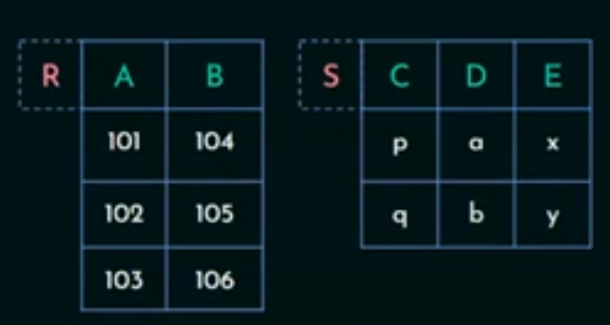
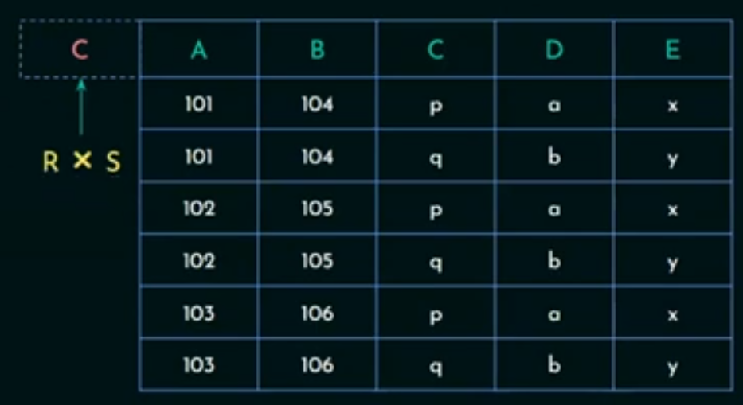
Cartesian Product (RΧS)
Combines information of two different relations into one.

Slide 16
Join( )
JOIN Operation (denoted by )
The sequence of CARTESIAN PRODUCT followed by SELECT is used quite commonly to identify and select related tuples from two relations
R _{<join condition>}S
where R and S can be any relations that result from general relational algebra expressions.

Slide 17
Join( )
Types of JOIN Operation
Inner Join: include only those tuples that satisfy the matching criteria, while the rest of tuples excluded
Theta
Equi join
Natural join
Outer Join used when we want to keep all the tuples in R, or all those in S, or all those in both relations in the result of the join, regardless of whether or not they have matching tuples in the other relation.
Outer join = Natural join +external information(from left, right, or both table)
Left outer join
Right outer join
Full outer join

Slide 18
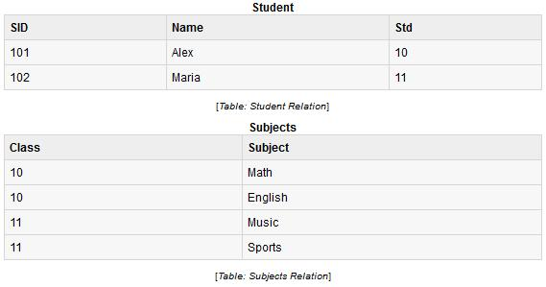
Theta (θ) join
Combines tuples from different relations provided they satisfy the theta condition.
Where θ is condition
Example:

Slide 19
Student student. std<subject.class Subject
SID | Name | Std | Class | subject
101 | Alex | 10 | 11 | Music
101 | Alex | 10 | 11 | Sport
Equi-Joins : When Theta join uses only equality comparison operator
Student student. std=subject.class Subject

Slide 20
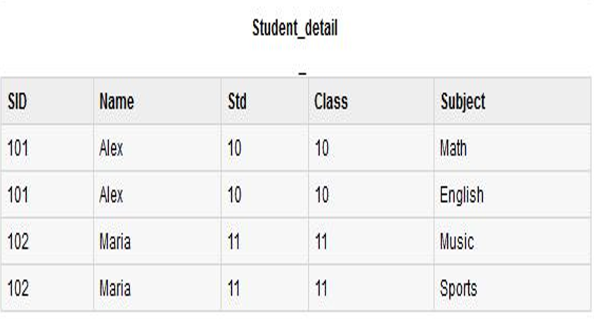

Slide 21
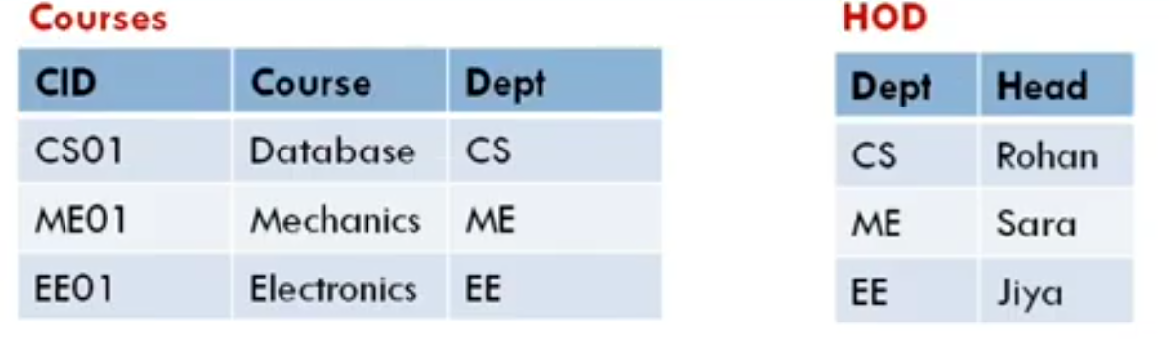
Cont’d
Natural joins: can only be performed if there is at least one common attribute exists between relation.
Attribute must have the same name and domain

Slide 22
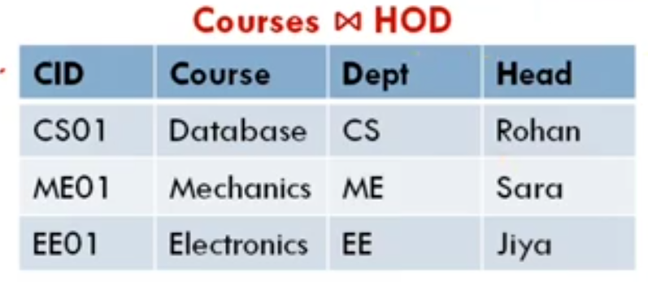
Cont’d

Slide 23
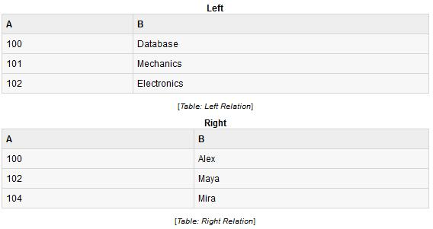
Left outer join ( R S )
Returns all records from the left table, and the matched records from the right table.
If no matching tuple is found in right, then the attributes of right in the join result are filled or “padded” with null values.

Slide 24
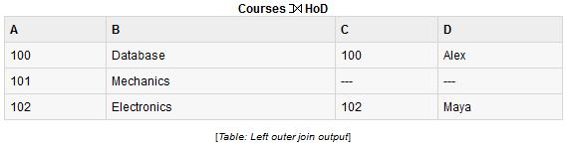
Left outer join ( R S )

Slide 25
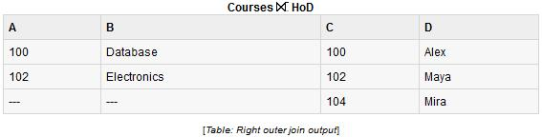
Right outer join: ( R S )
Returns all records from the right table, and the matched records from the left table

Slide 26
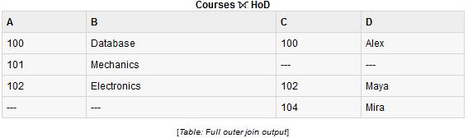
Full outer join: (R )
Returns all records when there is a match in either left or right table

Slide 27
Thank you!!

